Slide 1
Android Team: Abhay Gupta Gaurav Halbe Mayank Chacko Rohit Kandhal
Walk North Hills

Slide 2
Presentation Outline
About the ‘Walk Campaign’
Features
Prototype
Challenges
Q&A

Slide 3
About the ‘Walk Campaign’
Initiated by Matt Tomasulo
Encourage people to walk
Integrates key features of initial physical campaign

Slide 4
Primary Features
On demand proximity and way-finding in North Hills
Places categorization
List places based on time to reach by walk
Navigation to destination

Slide 5
Additional Features
Search places by name
Add places to favorites
Display weather conditions
Achievements (share on Facebook)

Slide 6
Prototype

Slide 7
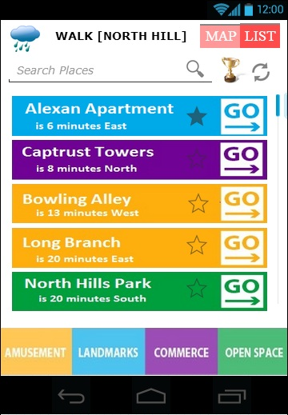
Main Screen

Slide 8
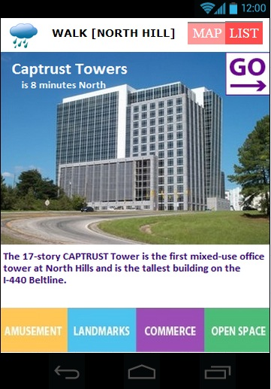
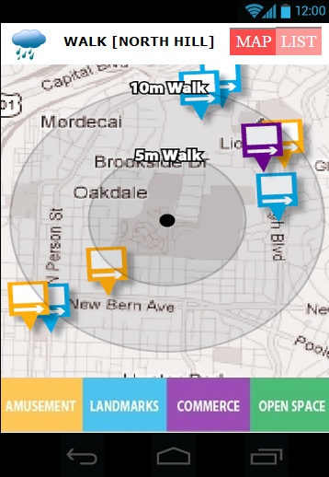
Places on Map

Slide 9
Place info

Slide 10
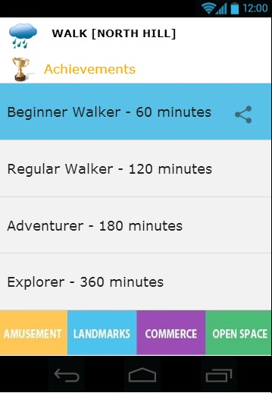
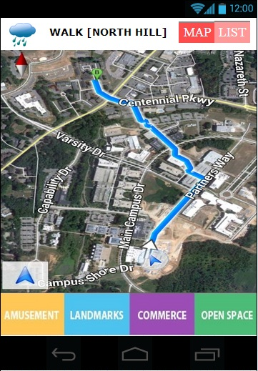
Navigation to Destination

Slide 11
Achievements

Slide 12
Challenges
Integrate with Google maps
Calculating distance for nearby places
Weather integration

Slide 13
Questions?

